Slide 1
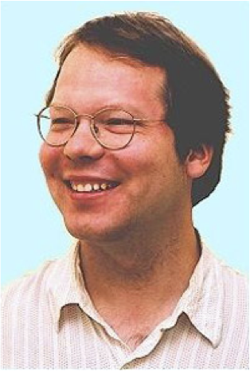




What is the Value of an Action in Ice Hockey? Learning a Q-function for the NHL
Oliver Schulte
Zeyu Zhao
Kurt Routley
Tim Schwartz
Computing Science/Statistics
Simon Fraser University
Burnaby-Vancouver, Canada
Notes:
15 minutes, 5 min questions.
Should add more hockey pictures.
Mention moneyball movie.

Slide 2

Big Picture: Sports Analytics meets Reinforcement Learning
Reinforcement Learning: Major branch of Artificial Intelligence (not psychology).
Studies sequential decision-making under uncertainty.
Studied since the 1950s
Many models, theorems, algorithms, software.
Reinforcement Learning
Sports
Analytics
on-line intro text
by Sutton and Barto
Notes:
https://www.plunkettresearch.com/industries/sports-recreation-leisure-market-research/
hudl.com

Slide 3
Markov Game Models

Slide 4
Markov Game
Fundamental model type in reinforcement learning: Markov Decision Process.
Multi-agent version: Markov Game.
Models dynamics: e.g. given the current state of a match, what event is likely to occur next?
Application in this paper:
value actions.
compute player rankings.

Slide 5
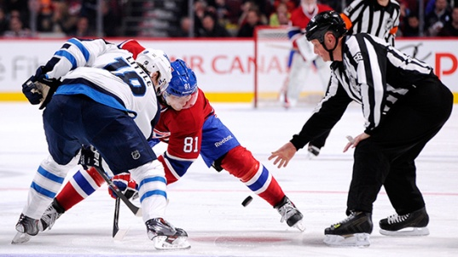
Markov Game Dynamics Example
Home = Colorado
Away = St. Louis
Differential = Home - Away
Initial State
Goal Differential = 0,
Manpower Differential = 2,
Period = 1
face-off(
Home,Offensive Zone)
0,2,1
[face-off(Home,Off.)]
Time in Sequence (sec)
0 sec
Alexander Steen wins Face-off in Colorado’s Offensive Zine
Notes:
single play-by-play sequence.
Each action leads to a transition.
Actions are not always shown on edges below.

Slide 6

Markov Game Dynamics Example
0,2,1
[face-off(Home,Off.)
Shot(Away,Off.)]
GD = 0, MD = 2, P = 1
0,2,1
[face-off(Home,Off.)]
Time in Sequence (sec)
0 sec
Alexander Steen wins Face-off
16 sec
Matt Duchen shoots

Slide 7
Markov Game Dynamics Example
0,2,1
[face-off(Home,Off.)
Shot(Away,Off.)]
0,2,1
[face-off(Home,Off.)
Shot(Away,Off.)
Shot(Away,Off.)]
GD = 0, MD = 2, P = 1 P(Away goal) = 32%
0,2,1
[face-off(Home,Off.)]
Time in Sequence (sec)
0 sec
Alexander Steen wins Face-off
16 sec
Matt Duchen shoots
22 sec
Alex Pientrangelo shoots
41 sec
Tyson Barries shoots
42 sec
sequence ends

Slide 8
Markov Game Dynamics Example
0,2,1
[face-off(Home,Off.)
Shot(Away,Off.)]
0,2,1
[face-off(Home,Off.)
Shot(Away,Off.)
Shot(Away,Off.)]
0,2,1
[face-off(Home,Offensive),
Shot(Away,Offensive),
Shot(Away,Offensive),
Shot(Home,Offensive)]
GD = 0, MD = 2, P = 1 P(Away goal) = 32%
0,2,1
[face-off(Home,Off.)]
Time in Sequence (sec)
0 sec
Alexander Steen wins Face-off
16 sec
Matt Duchen shoots
22 sec
Alex Pientrangelo shoots
41 sec
Tyson Barries shoots
42 sec
sequence ends

Slide 9
Markov Game Dynamics Example
0,2,1
[face-off(Home,Off.)
Shot(Away,Off.)]
0,2,1
[face-off(Home,Off.)
Shot(Away,Off.)
Shot(Away,Off.)]
0,2,1
[face-off(Home,Offensive),
Shot(Away,Offensive),
Shot(Away,Offensive),
Shot(Home,Offensive)]
0,2,1
[face-off(Home,Off.),
Shot(Away,Off.),
Shot(Away,Off.),
Shot(Home,Off.),
Stoppage]
GD = 0, MD = 2, P = 1 P(Away goal) = 32%
0,2,1
[face-off(Home,Off.)]
Time in Sequence (sec)
0 sec
Alexander Steen wins Face-off
16 sec
Matt Duchen shoots
22 sec
Alex Pientrangelo shoots
41 sec
Tyson Barries shoots
42 sec
sequence ends

Slide 10
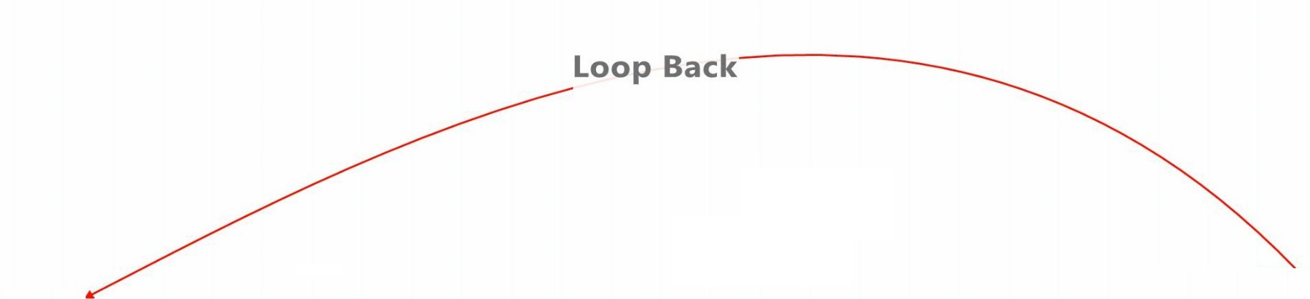
Markov Game Dynamics Example
0,2,1
[face-off(Home,Off.)
Shot(Away,Off.)]
0,2,1
[face-off(Home,Off.)
Shot(Away,Off.)
Shot(Away,Off.)]
0,2,1
[face-off(Home,Offensive),
Shot(Away,Offensive),
Shot(Away,Offensive),
Shot(Home,Offensive)]
0,2,1
[face-off(Home,Off.),
Shot(Away,Off.),
Shot(Away,Off.),
Shot(Home,Off.),
Stoppage]
GD = 0, MD = 2, P = 1 P(Away goal) = 32%
0,2,1
[face-off(Home,Off.)]
Time in Sequence (sec)
0 sec
Alexander Steen wins Face-off
16 sec
Matt Duchen shoots
22 sec
Alex Pientrangelo shoots
41 sec
Tyson Barries shoots
42 sec
sequence ends

Slide 11
Markov Game Description
Two agents, Home and Away.
Zero-sum: if Home earns a reward of r, then Away receives –r.
Rewards can be
win match
score goal
receive penalty (cost).

Slide 12
Learning Markov Game Parameters

Slide 13
Markov Game Transition Probabilities = Parameters
Big Data: Play-by-play
2007-2015
Big Model: 1.3 M states
Notes:
Away: MD Not 2 = Penalty Ends.

Slide 14
Action Values
Player Performance Evaluation

Slide 15
Expected rewards
Key quantity in Markov game models: the total expected reward for a player given the current game state.
Written V(s).
Looks ahead over all possible game continuations.
dynamic programming
total expected reward of state s
transition probabilities

Slide 16
Q-values and Action Impact
Q(s,a) = the expected total reward if action a is executed in state s.
The action-value function.
Expected reward after action
Expected reward before action

Slide 17
Q-value Ticker
Q-value = P(that away team scores next goal)
0,2,1
[face-off(Home,Off.)
Shot(Away,Off.)]
P(Away goal) = 36%
0,2,1
[face-off(Home,Off.)
Shot(Away,Off.)
Shot(Away,Off.)]
P(Away goal) = 35%
0,2,1
[face-off(Home,Offensive),
Shot(Away,Offensive),
Shot(Away,Offensive),
Shot(Home,Offensive)]
P(Away goal) = 32%
0,2,1
[face-off(Home,Off.),
Shot(Away,Off.),
Shot(Away,Off.),
Shot(Home,Off.),
Stoppage]
P(Away goal) = 32%
GD = 0, MD = 2, P = 1 P(Away goal) = 32%
0,2,1
[face-off(Home,Off.)]
P(Away goal) = 28%
Time (sec)
0 sec
Alexander Steen wins Face-off
16 sec
Matt Duchen shoots
22 sec
Alex Pientrangelo shoots
41 sec
Tyson Barries shoots
42 sec
sequence ends
Notes:
Impact = difference between successive Q-values.
Recall that the transition probability depends on the action taken.

Slide 18
Advantages of Impact Value
Context-Aware.
e.g. goals more valuable in ties than when ahead.
Look Ahead:
e.g. penalties➔ powerplay ➔ goals but not immediately.

Slide 19

Computing Player Impact
From the Q-function, compute impact values of state-action pairs.
For each action that a player takes in a game state, find its impact value.
Sum player action impacts over all games in a season. (Like +/-).

Slide 20
Results 2014-2015 1st half
The Blues’ STL line comes out very well.
Tarasenko is under-valued, St. Louis increased his salary 7-fold.

Slide 21
Results 2013-2014 Season
Jason Spezza: high goal impact, low +/-.
plays very well on poor team (Ottawa Senators).
Requested transfer for 2014-2015 season.
Notes:
Transferred to Dallas Stars.
Ottawa senators: goal diff of -29.

Slide 22
Consistency Across Seasons
Correlation coefficient = 0.703
Follows Pettigrew(2015)

Slide 23
Related Work
Routley and Schulte, UAI 2015
Values of Ice Hockey Actions, compares with THoR (Schuckers and Curro 2015).
Ranks players by impact on goals and penalties.
Pettigrew, Sloan 2015.
reward = win.
estimates impact of goal on win probability given score differential, manpower differential, game time.
Cervone et al., Sloan 2014.
Conceptually similar but for basketball.
our impact function = their EPVA.
uses spatial tracking data.

Slide 24
Conclusion
Reinforcement Learning ➔ Model of Game Dynamics.
Connects advanced machine learning with sports analytics.
Application in this paper:
use Markov game model to quantify impact of a player’s action (on expected reward).
use total impact values to rank players.
Impact value
is aware of context.
looks ahead to game future trajectory.
Total impact value is consistent across seasons.

